Slide 1

Welcome to CS244 Spring 2020!
Class will start shortly

Slide 2
CS244
Advanced Topics in Networking
Lecture 8: SDN (1)
Nick McKeown
“Ethane: Taking Control of the Enterprise”
[Martin Casado et al, 2007]
“OpenFlow: Enabling Innovation in Campus Networks” [A bunch of networking profs, 2008]
Spring 2020

Slide 3
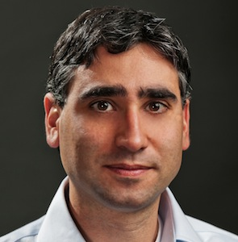
Context
Martín Casado
Previously at LLNL
Stanford CS PhD 2007
Founded Nicira
GM for networking at VMware
Now GP at A16Z
Inventor: SDN and network virtualization (next Tuesday’s class)

Slide 4
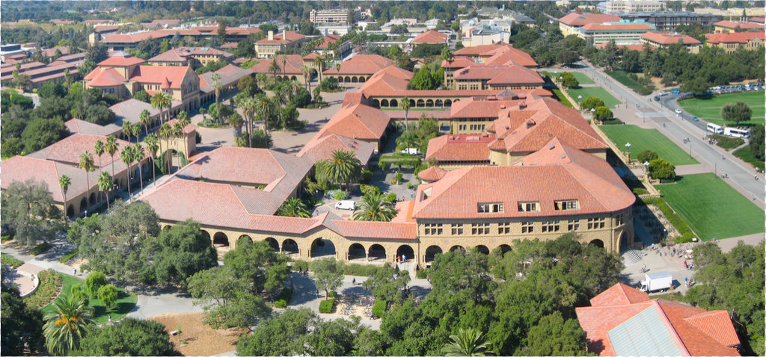
How difficult is it to define all network operations in software, outside the datapath?
Stanford campus
35,000 users
10,000 new flows/sec
137 network policies
2,000 switches
2,000 switch CPUs
2006

Slide 5
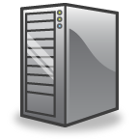


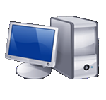
Extreme thought experiment: What if software decides whether to accept each flow, and how to route it?
Controllers
Ethernet
Switch
Ethernet
Switch
Ethernet
Switch
Host B
Host A
Ethernet
Switch

Slide 6
A question the team had: How many $400 servers do we need for 35,000 users?
Answer: less than one

Slide 7

If we can control the network centrally then (eventually) we will. With replication for fault-tolerance and performance scaling.
Q: Why might we want to control them centrally?
Q: How does this compare to how networks are controlled today?

Slide 8
You said (about controllers)
Margalit Glasgow
…there was not much discussion of the controller, which seems important for security reasons such that a user can only control specified traffic.
Sundararajan Renganathan What is the time penalty paid by new flows (and therefore users) while they wait to get themselves registered at the controller and for the controller to subsequently update the flow tables at all the switches?
Wil Kautz
Aren't there major security issues with placing so much of the important decision-making power of the network in a single location? Doesn't a security vulnerability in that single location affect the entire network?

Slide 9
Ethane and Network Policy
Policy
“Laptops can’t accept incoming connections”
“A can’t talk to B”
Remote Control Plane
Control
Packet
Forwarding
Control
Packet
Forwarding
Control
Control
Packet
Forwarding
Packet
Forwarding
Control
Packet
Forwarding
Notes:
AS you may know, Ethane is a proposed way to build enterprise networks. Rather than login to every switch to configure it, the control plane is logically centralized. The operator creates a policy which is compiled down to forwarding rules in the switches. We build a prototype for about 300 users.
Martin, Scott Shenker and I were wondering whether to continue with Ethane and what would happen next. This was obviously a precursor to OpenFlow and then SDN.

Slide 10
The approach was starting elsewhere…
Public WANs: Route reflectors decide routes centrally, and download to datapath
AT&T Backbone
WiFi: CAPWAP and Meraki; Ubiquiti
Cable TV: Docsis
Disaggregation: Datacenter owners were considering build their own networking equipment.

Slide 11
Example: Big Data Center
Cost
500,000 servers
25,000 switches
$10k per legacy switch = $250M
$2k disaggregated switch = $50M
Savings in 5 data centers = $1Bn
Control
Centralized remote control is easier
“Centralize if you can, distribute if you can’t”
Customized, differentiated network
Home grown traffic engineering
50% utilization → 95% utilization
By 2008, Google and Amazon were starting to write their own software

Slide 12
Internet Service Providers (ISPs)
Revenue
Global IP traffic growing 40-50% per year
End-customer monthly bill unchanged
Therefore, CAPEX and OPEX need to reduce 40-50% per Gb/s per year
But in practice, reduces by ~20% per year
$30/month
Total cost
Growth in traffic
time

Slide 13
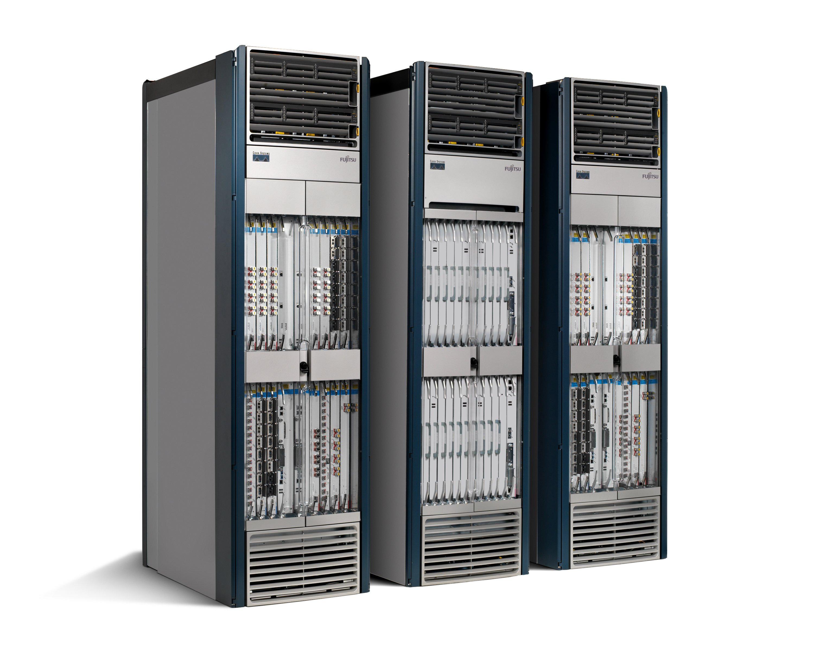
What a big Internet router looked like
Routing, management, mobility management, access control, VPNs, …
Feature
Feature
Million of lines of source code
7,000 Internet RFCs
Operating
System
Custom Forwarding Hardware
Billions of gates
Bloated
Power Hungry
Overly complex
Mainframe mentality
Too expensive

Slide 14
After Ethane: What was next?
Microsoft: “Come on in….”
Cisco: “It will never work…”
Raw nerve.
We must be onto something.

Slide 15
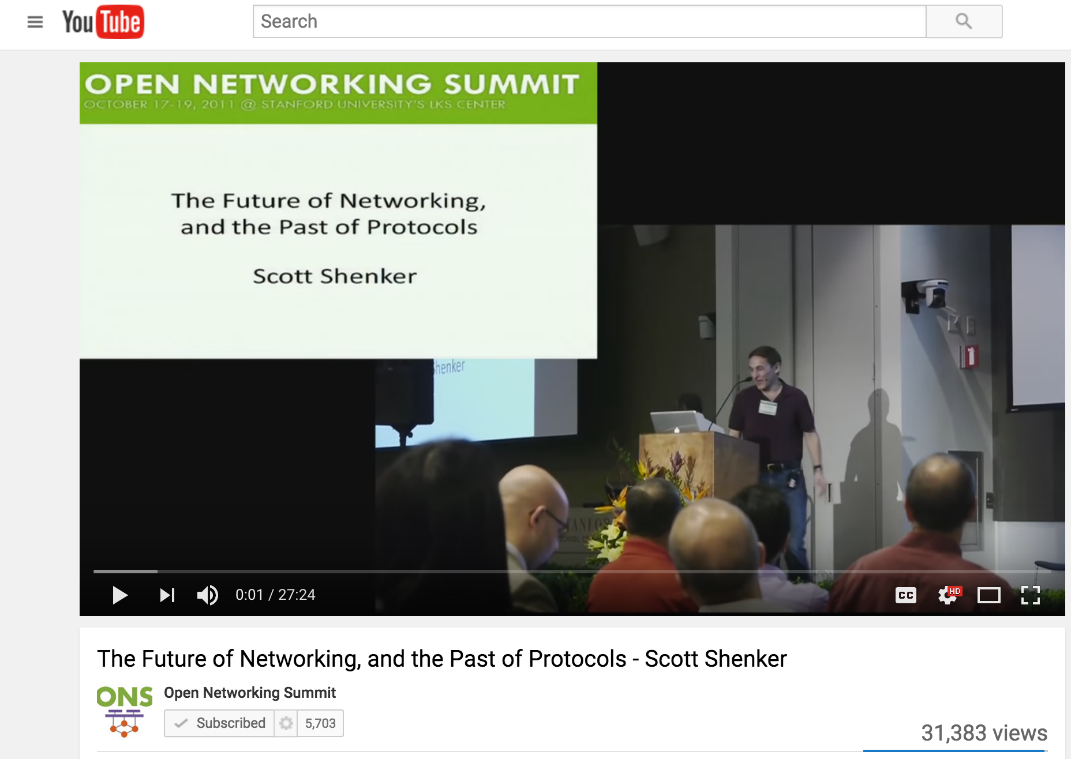
“The Future of Networking and the Past of Protocols” Scott Shenker 2011
Notes:
Scott Shenker famously said 5 years ago in his talk <slide of Scott’s talk> on “The Future of Networking and the Past of Protocols”: he said
“People who run networks have to keep a superhuman amount of state in their heads, which means networks today are run by Masters of Complexity.”

Slide 16
Networks today are run by
“Masters of Complexity”
Notes:
We have got used to a state of affairs in networking in which it’s really hard to observe what the network is doing, and it requires experts with many years of experience to understand and fix problems.
we have developed good abstractions for the data plane, where we use “layers” and encapsulation to separate concerns -but we haven’t yet developed good abstractions for the control plane. If we make clever architectural choices and create clean abstractions, we will be able to write control plane applications without worrying about the lower level details.

Slide 17
Abstractions in computer systems
Virtual memory: Abstract illusion of infinite, private physical memory
File system: Uniform illusion of read/write data store.
Operating system: Shields user from CPU scheduling and peripheral sharing.
…
Notes:
The world of computing is built on a foundation of clever abstractions.
The abstraction of virtual memory means our applications don’t have to worry about managing physical memory locations and caches. Abstractions for file systems means our applications can open, update and close files without needing to know what hardware the file system uses, or where it is located. The abstraction of an operating system means our applications don’t have to worry about how processes are scheduled and peripherals are shared.

Slide 18
“Modularity based on abstraction is the way things are done!”
Barbara Liskov (MIT) Turing Award Lecture 2009
Notes:
As Barbara Liskov said about computer science: “Modularity based on abstraction is the way things are done!” Abstractions are arguably the foundation upon which computers and entire data-centers are built.
I actually think the past ten years in networking has been all about creating new abstractions for network control planes.

Slide 19
SDN: An early definition
A network in which the control plane is physically separate from the forwarding plane.
and
A single control plane controls several forwarding devices.
(Evolved over time)

Slide 20
Software Defined Network (SDN)
Control
Program
Control
Program
Control
Program
Global Network Map
Control Plane (“Network OS”)
Control
Packet
Forwarding
Control
Packet
Forwarding
Control
Control
Packet
Forwarding
Packet
Forwarding
Control
Packet
Forwarding

Slide 21
OpenFlow

Slide 22
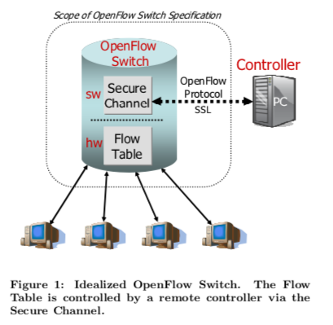
Motivation for OpenFlow
“Thus, the commercial solutions are too closed and inflexible, and the research solutions either have insufficient performance or fanout, or are too expensive. It seems unlikely that the research solutions, with their complete generality, can overcome their performance or cost limitations. A more promising approach is to compromise on generality and to seek a degree of switch flexibility that is:
Amenable to high-performance and low-cost implementations.
Capable of supporting a broad range of research.
Assured to isolate experimental traffic from production traffic.
Consistent with vendors’ need for closed platforms."

Slide 23
Match-Action Forwarding Abstraction
Action Primitives
“Forward to ports 4 & 5”
“Push header Y after bit 12”
“Pop header bits 8-12”
“Decrement bits 13-18”
“Drop packet”
…
“Plumbing primitives”
H
H’
Match | Action
F | Action(F)
G | Action(G)
H | Action(H)
Notes:
At a high level we can think of OpenFlow as a direct implementation of a “match-action” model of processing.
This model easily captures current switches, such as Ethernet swithces, IP routers and MPLS switches.
If there are multiple layers of protocols handled on a box, it’s easier to think of it as a sequence of tables….

Slide 24
Multiple Table Match-Action
H_{n}
H₁
H’
Match | Action
F₁ | Action(F)
G₁ | Action(G)
H₁ | Action(H)
Match | Action
F_{n} | Action(F)
G_{n} | Action(G)
H_{n} | Action(H)
Notes:
… where each protocol is processed in its own table. For example, the first tabnle might be an exact match in a VLAN table in SRAM, and the last one might be an access control list entry in a TCAM.

Slide 25
OpenFlow Goals (as described at the time)
Short-term, backward compatability
Match: include well-known header fields.
Action: necessary set for existing protocols.
Support existing protocols on existing switch chips.
Long-term
Match: Very general, not protocol specific.
Action: Small instruction set, not protocol specific.
Make it easy to add new headers and actions.
Any network (packet, circuit, radio).
Q: How well was each goal met?

Slide 26
You said
Kathryn Rydberg
How did the experiment of using OpenFlow in a few Stanford buildings go? Does more of the Stanford network now use OpenFlow? Is it prevalent at other universities now? Does OpenFlow affect the performance of non-research traffic?

Slide 27
OpenFlow: Control Abstraction
Control plane can run on modern servers
Can adopt software engineering best-practices
Easier to add new control programs
…or customize locally
Solve distributed systems problem once, rather than for every protocol

Slide 28
SDN: Software Defined Networks
2. At least one Network OS probably many. Open- and closed-source
3. Well-defined open API
Global
Network Map
Control
Program
Control
Program
Network OS
1. Open interface to packet forwarding (e.g. OpenFlow)
Packet
Forwarding
Packet
Forwarding
Packet
Forwarding
Packet
Forwarding
Packet
Forwarding

Slide 29
OSPF
Dijkstra
OSPF
Dijkstra
5%
Global Network Map
Network
Map
95%
Network OS
OS
Specialized
Hardware
Packet
Forwarding
Packet
Forwarding
Packet
Forwarding
RFC 2328: 245 pages
Distributed System
Builds consistent, up-to-date map of the network: 101 pages
Dijkstra’s Algorithm: 1 page
Packet
Forwarding

Slide 30
OpenFlow: Forwarding Abstraction
Vendor-agnostic interface to forwarding plane
Simpler, lower-cost, lower-power hardware

Slide 31
Match + Action abstraction
Pros
Simple abstraction of stateless forwarding (e.g. Ethernet, IPv4, IPv6, VLAN, VPNs, …)
Add/delete table entries: If a packet matches a field, then perform actions.
Allows one API to control multiple protocols
Enabled multiple controllers: NOX, POX, ONIX, Beacon, Floodlight, …
Easy to add to existing switches or new disaggregated switches (hence Google adoption)
Cons
Underlying functions were fixed, hard to add or evolve (hence P4 later)
Hard to introduce new versions of API
Switch vendors very reluctant to support

Slide 32
In the context of bigger networking industry changes

Slide 33
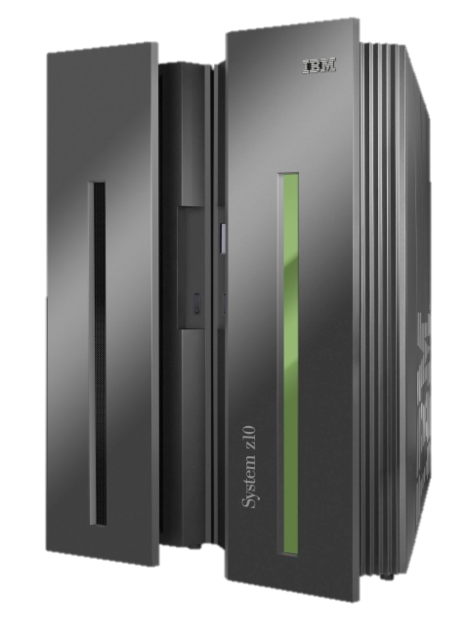
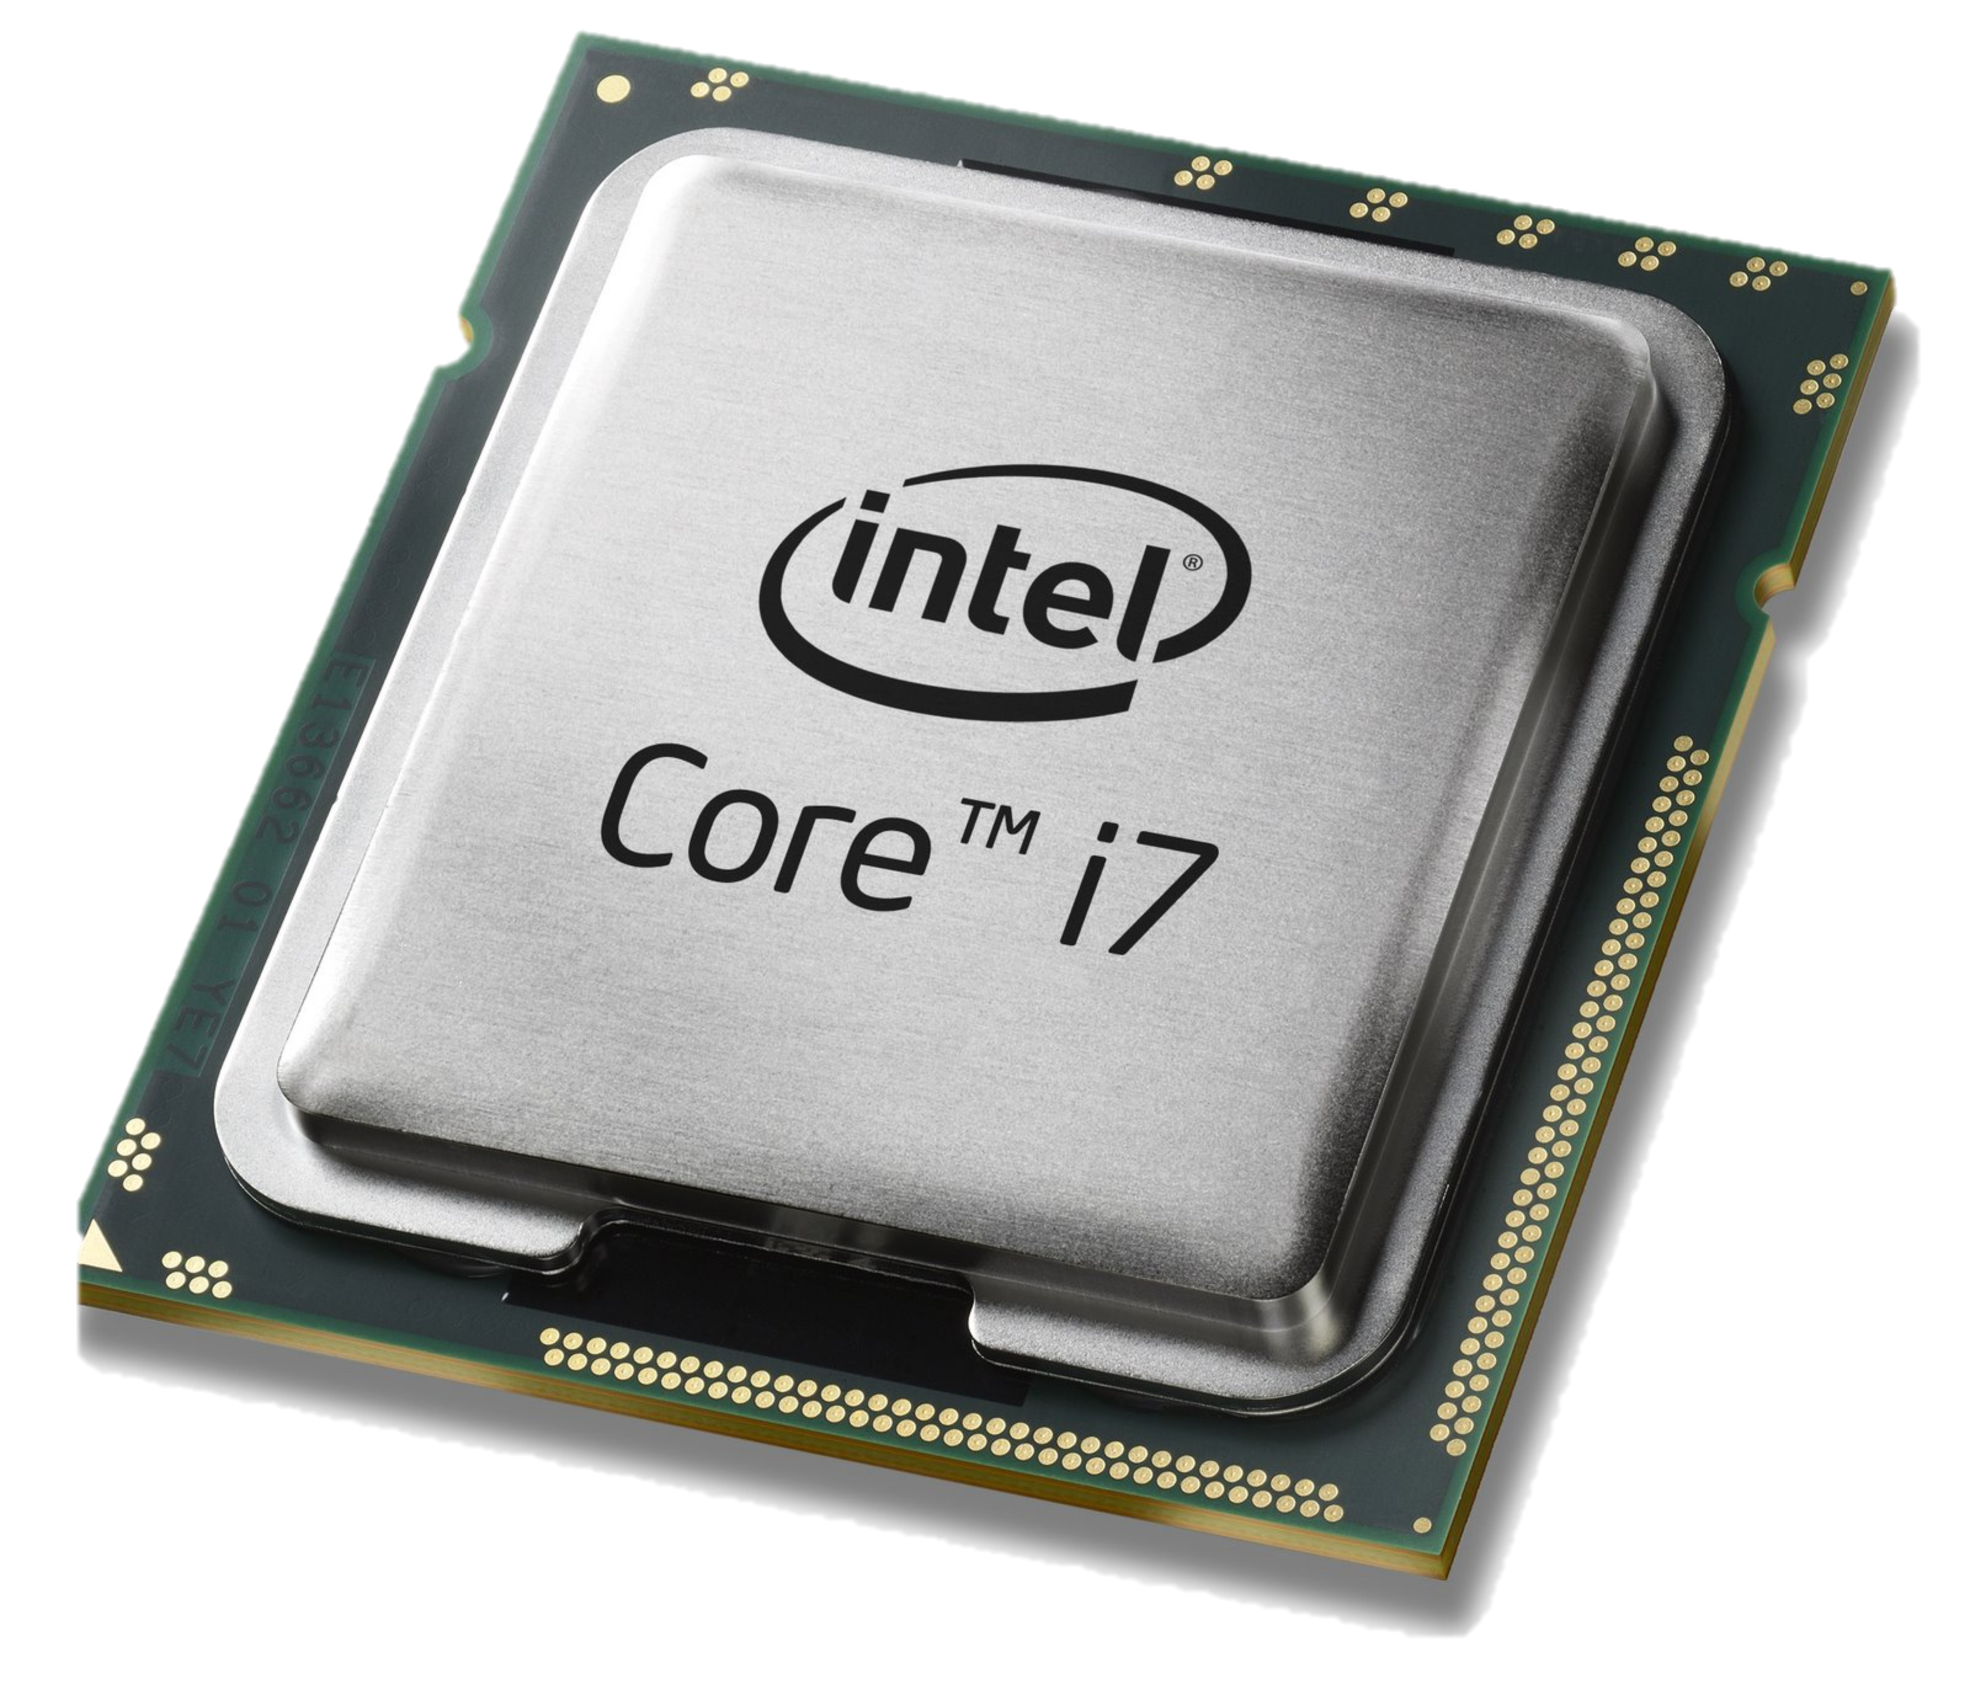
Computer Industry
App
App
App
App
App
App
App
App
App
App
App
Specialized
Applications
Open Interface
Specialized
Operating System
Windows
(OS)
Linux
Mac
OS
or
or
Open Interface
Specialized
Hardware
Microprocessor

Slide 34
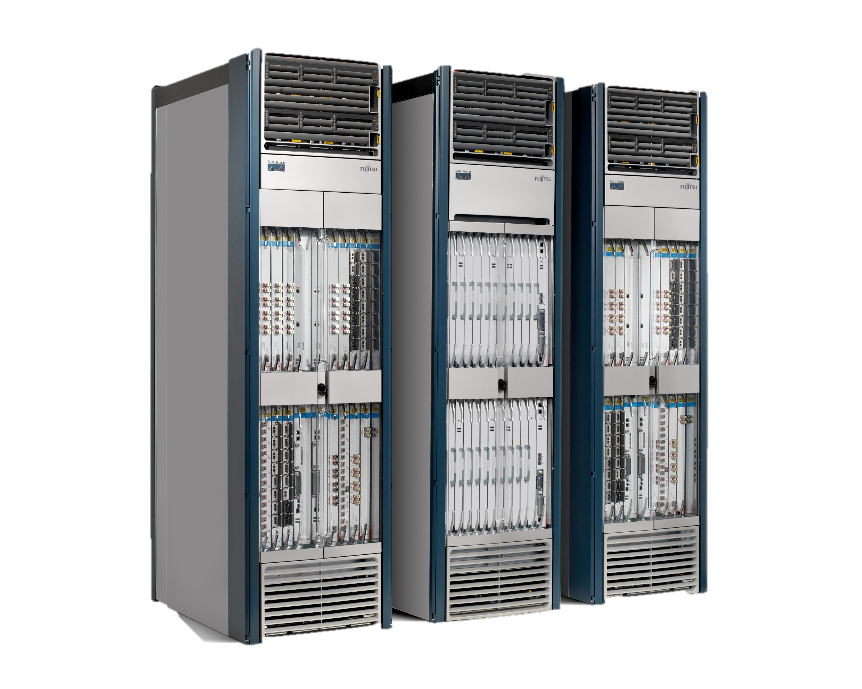
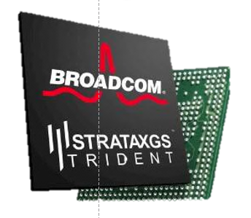
Networking Industry
App
App
App
App
App
App
App
App
App
App
App
Specialized
Features
Open Interface
NOX
Beacon
ONIX
POX
ONOS
Flood light
Trema
ODL
Ryu
Control Plane 1
Control Plane 2
Specialized
Operating System
Open Interface
Switch Chips
Specialized
Hardware
“Software is eating the world (of networking)”

Slide 35
Network Function Virtualization (NFV)
Public Internet
Middlebox
Firewalls
Load-balancing
NAT
Boundary routers
Deep Packet Inspection
DDoS Mitigation
Middlebox
Middlebox
Middlebox
Packet
Forwarding
Packet
Forwarding
Packet
Forwarding
Packet
Forwarding
Packet
Forwarding

Slide 36
Network Function Virtualization (NFV)
Public Internet
VM
VM
VM
Middlebox
Packet
Forwarding
VM
VM
VM
Firewalls
Load-balancing
NAT
Boundary routers
Deep Packet Inspection
DDoS Mitigation
Packet
Forwarding
Packet
Forwarding
Packet
Forwarding
Packet
Forwarding
Packet
Forwarding

Slide 37
With hindsight, Disaggregation, SDN and NFV were probably inevitable
Part of a bigger trend towards the owners and operators of networks taking control of how they work

Slide 38
Inevitable because…
Rise of Linux.
Rise of baremetal servers and data centers.
SDN: Rise of merchant switching silicon.
NFV: Rise of computer virtualization.

Slide 39
Today

Slide 40
Most networking equipment is disaggregating
Intra- and inter-datacenter networks
ISP routers and switches
WiFi APs
Cellular basestations (4G, 5G…)
Optical and Metro Transport
Residential broadband access
Enterprise network equipment: switch, router, firewall

Slide 41
Network Virtualization (next time)
Control
Programs
Control
Programs
Control
Programs
Abstract Network View
Network Virtualization
Global Network View
Network OS
Packet
Forwarding
Packet
Forwarding
Packet
Forwarding
Packet
Forwarding
Packet
Forwarding

Slide 42
End.

